Slide 1


Exclusively for North Springs Mamas
Take an extra 5% off any service booked in February
719-434-8361

Slide 2


When you think LIGHT,
Think Lytle
719-434-8361

Slide 3



Lighting the way for over 20 years

Slide 4



Is your electrical service outdated and overworked?
We will
re-”amp”
your system

Slide 5

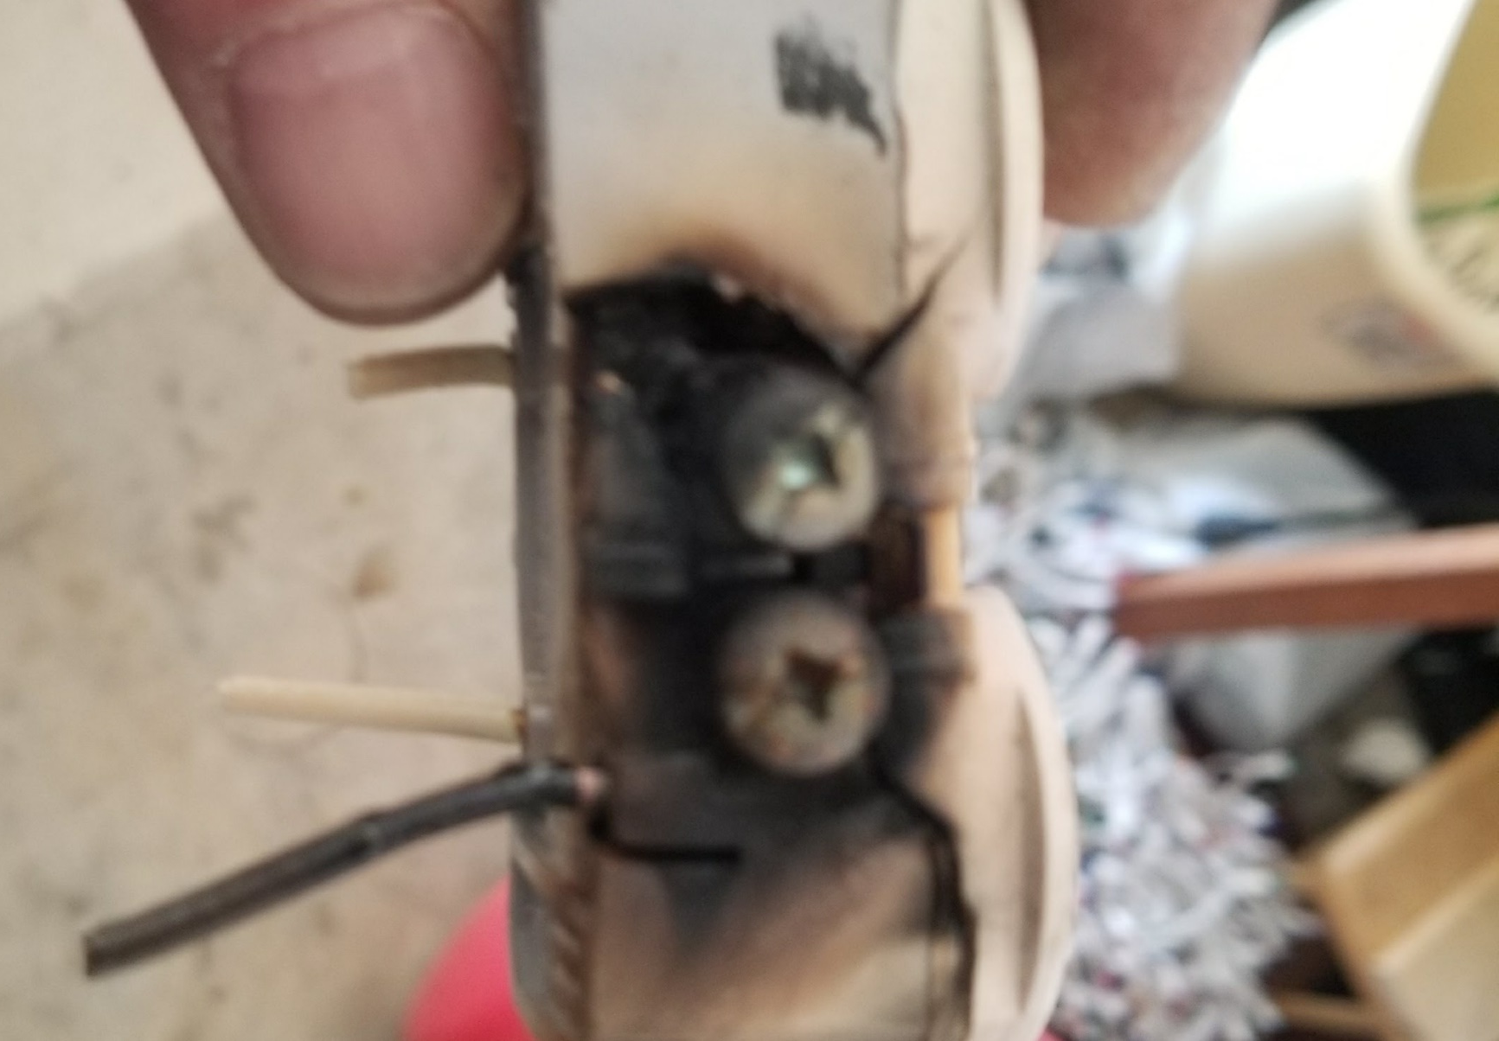

Too many wires cause electrical fires

Slide 6

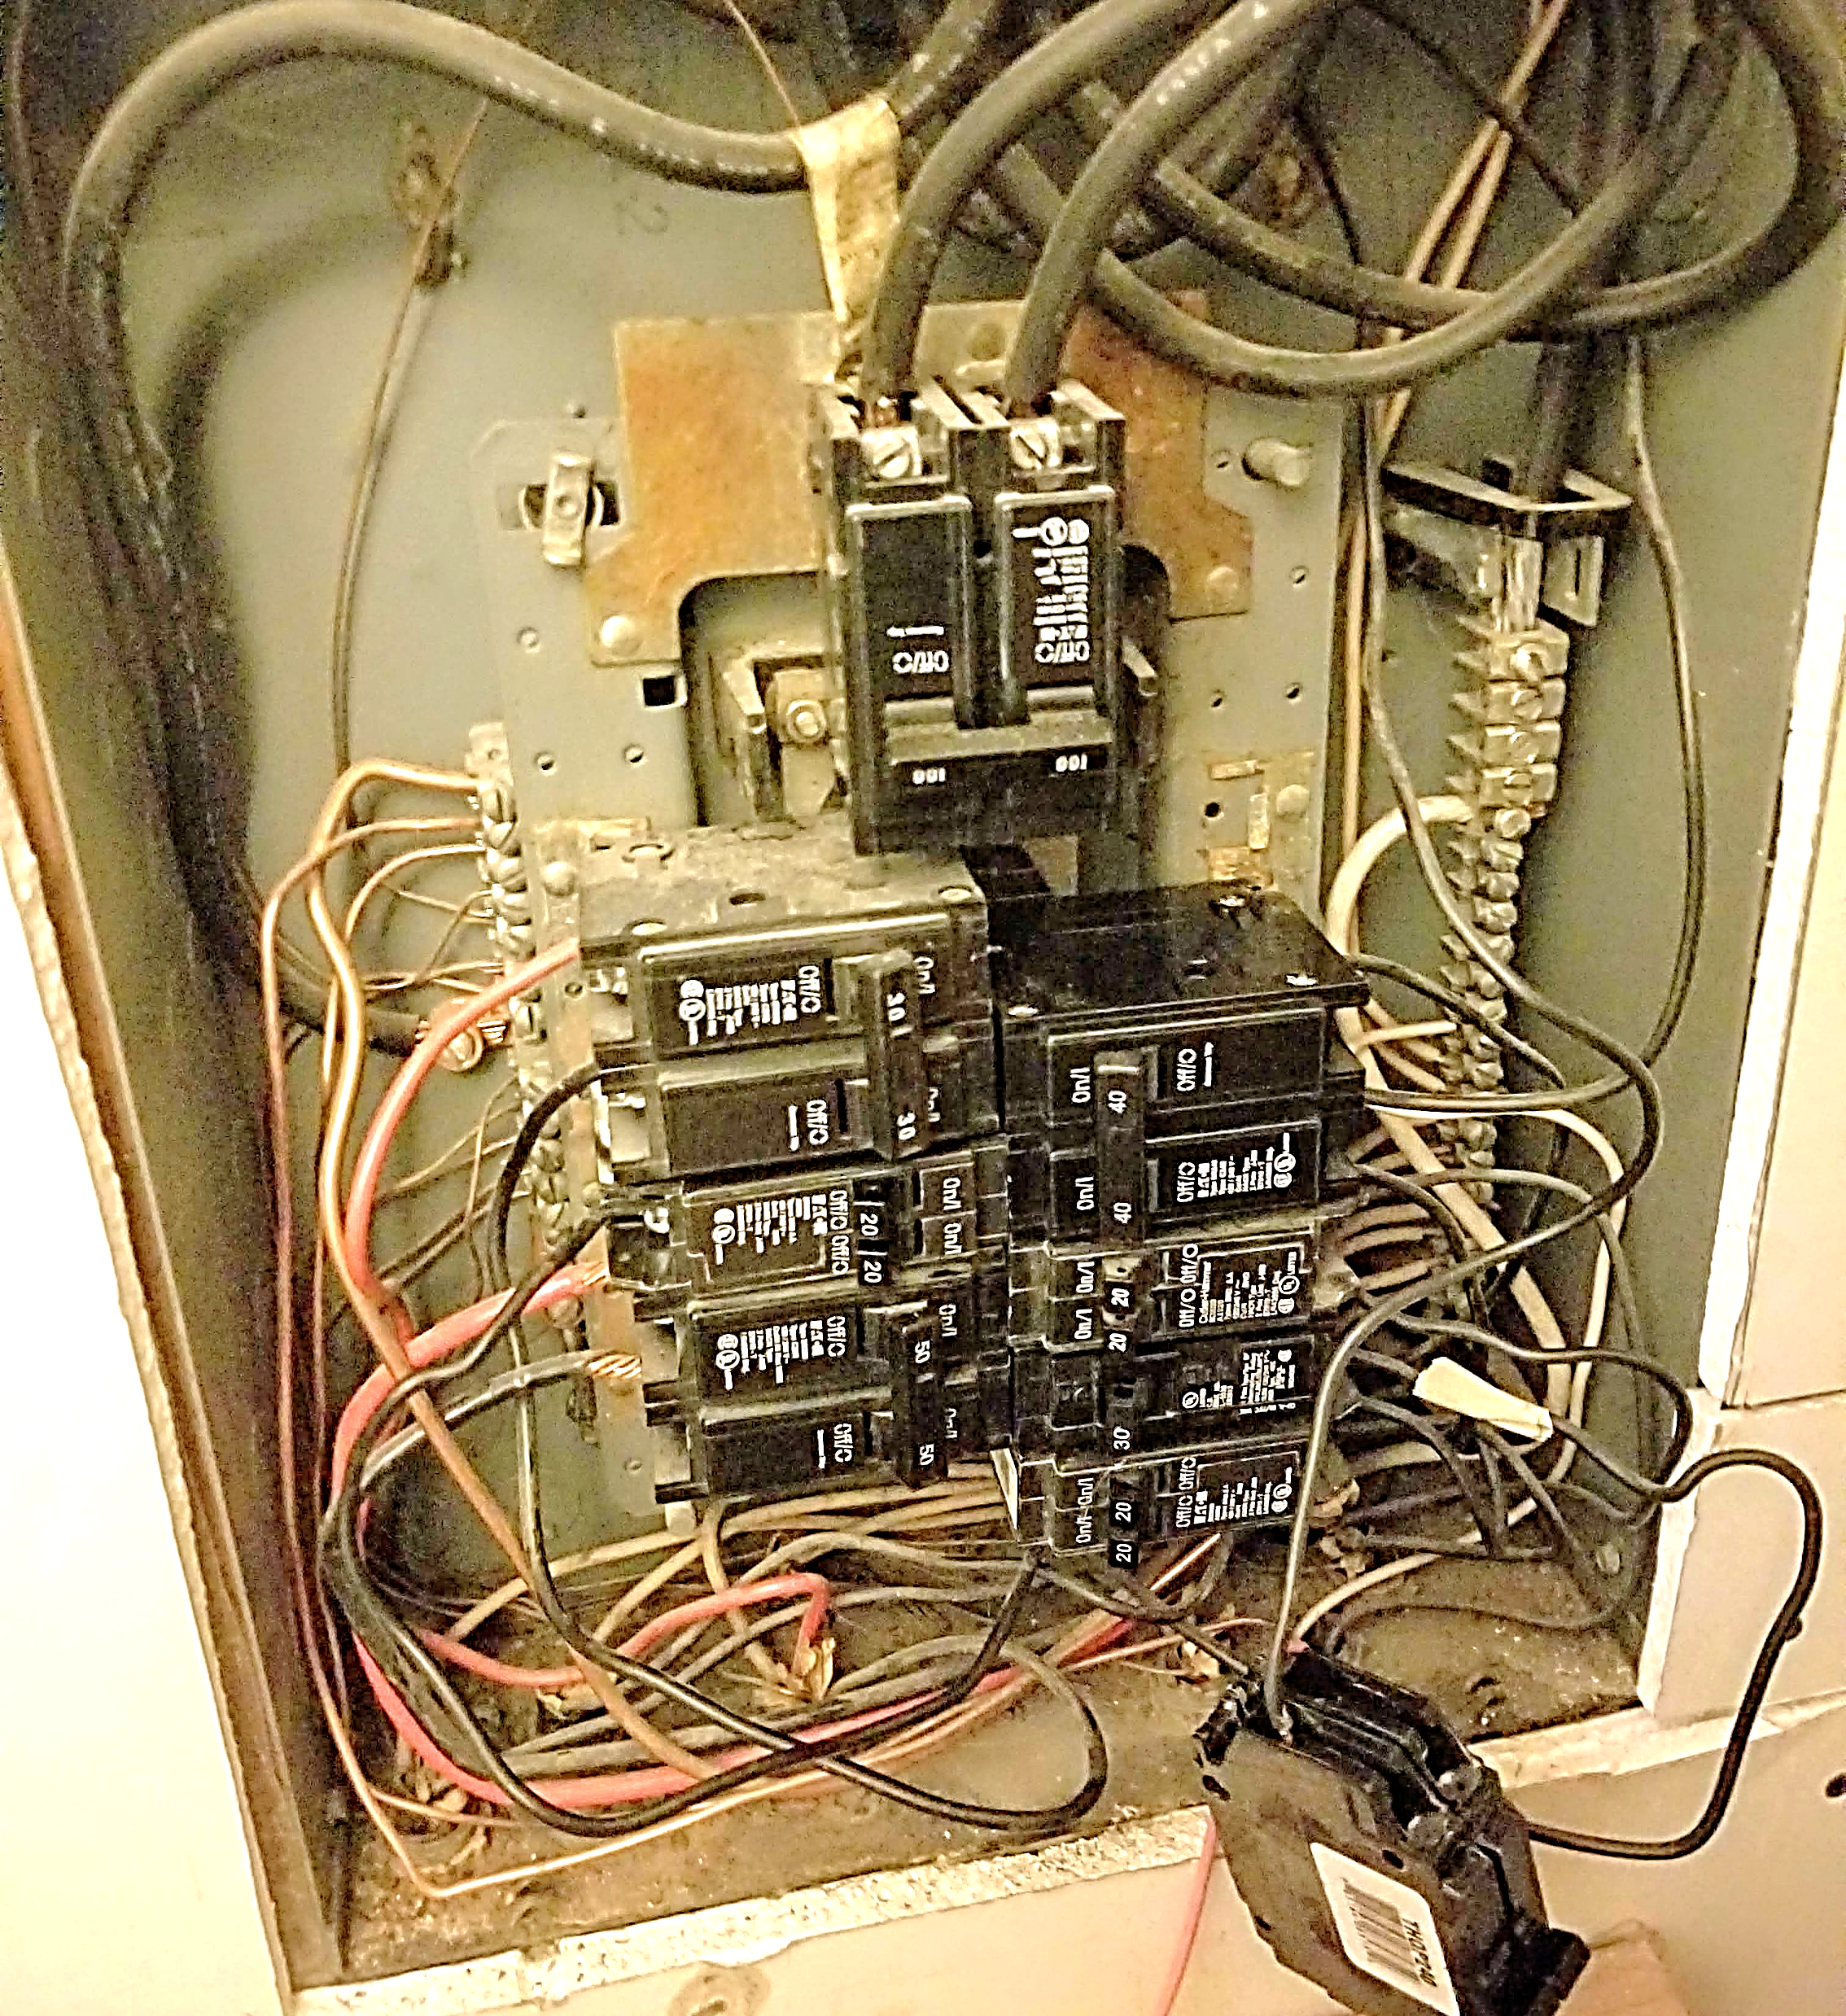
A loose connection needs correction
719-434-8361

Slide 7

We fix watt is broken

Slide 8

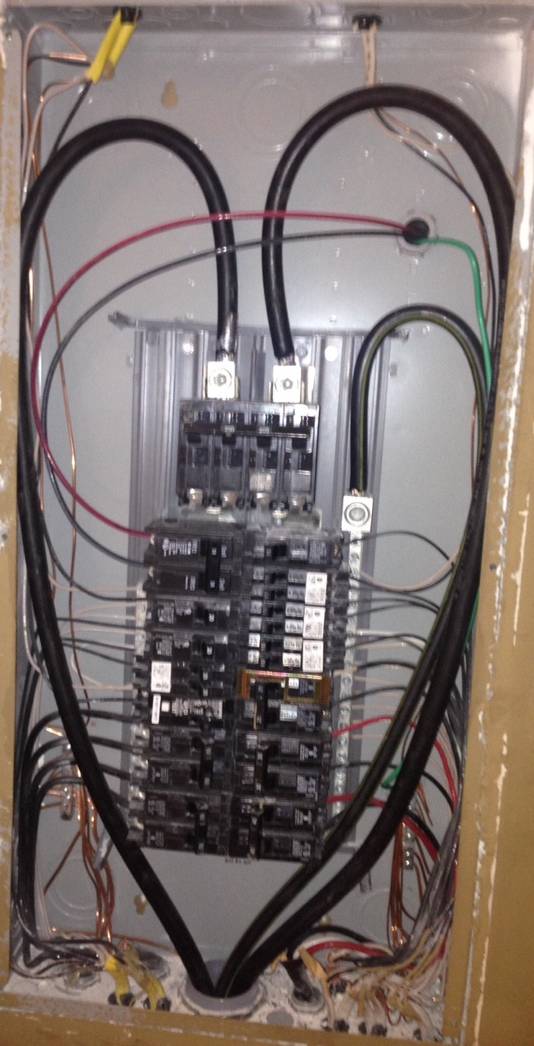
It warms our heart when your panel is a work of art
This Photo by Unknown Author is licensed under CC BY-SA

Slide 9
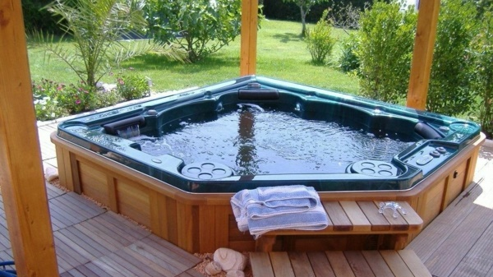

We will be quick on our installation,
so that you can get to your relaxation
719-434-8361
This Photo by Unknown Author is licensed under CC BY-ND

Slide 10

Lighting the way for over 20 years
719-434-8361

Slide 11


719-434-8361
You light up my life.
Happy Valentine’s Day

Slide 12
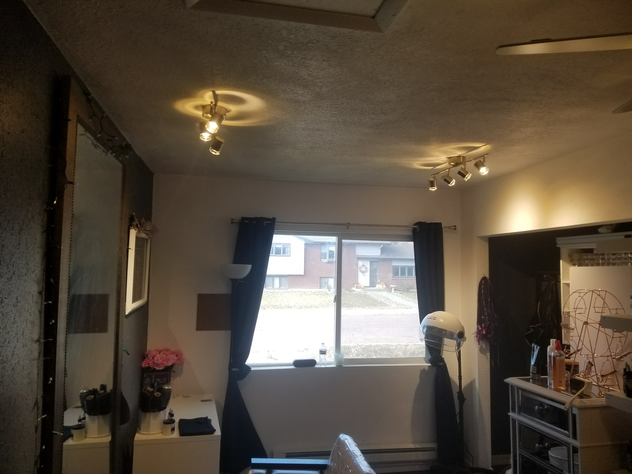
Keeping your lighting on track
719-434-8361

Slide 13

Giving the gift of light
719-434-8361

Slide 14
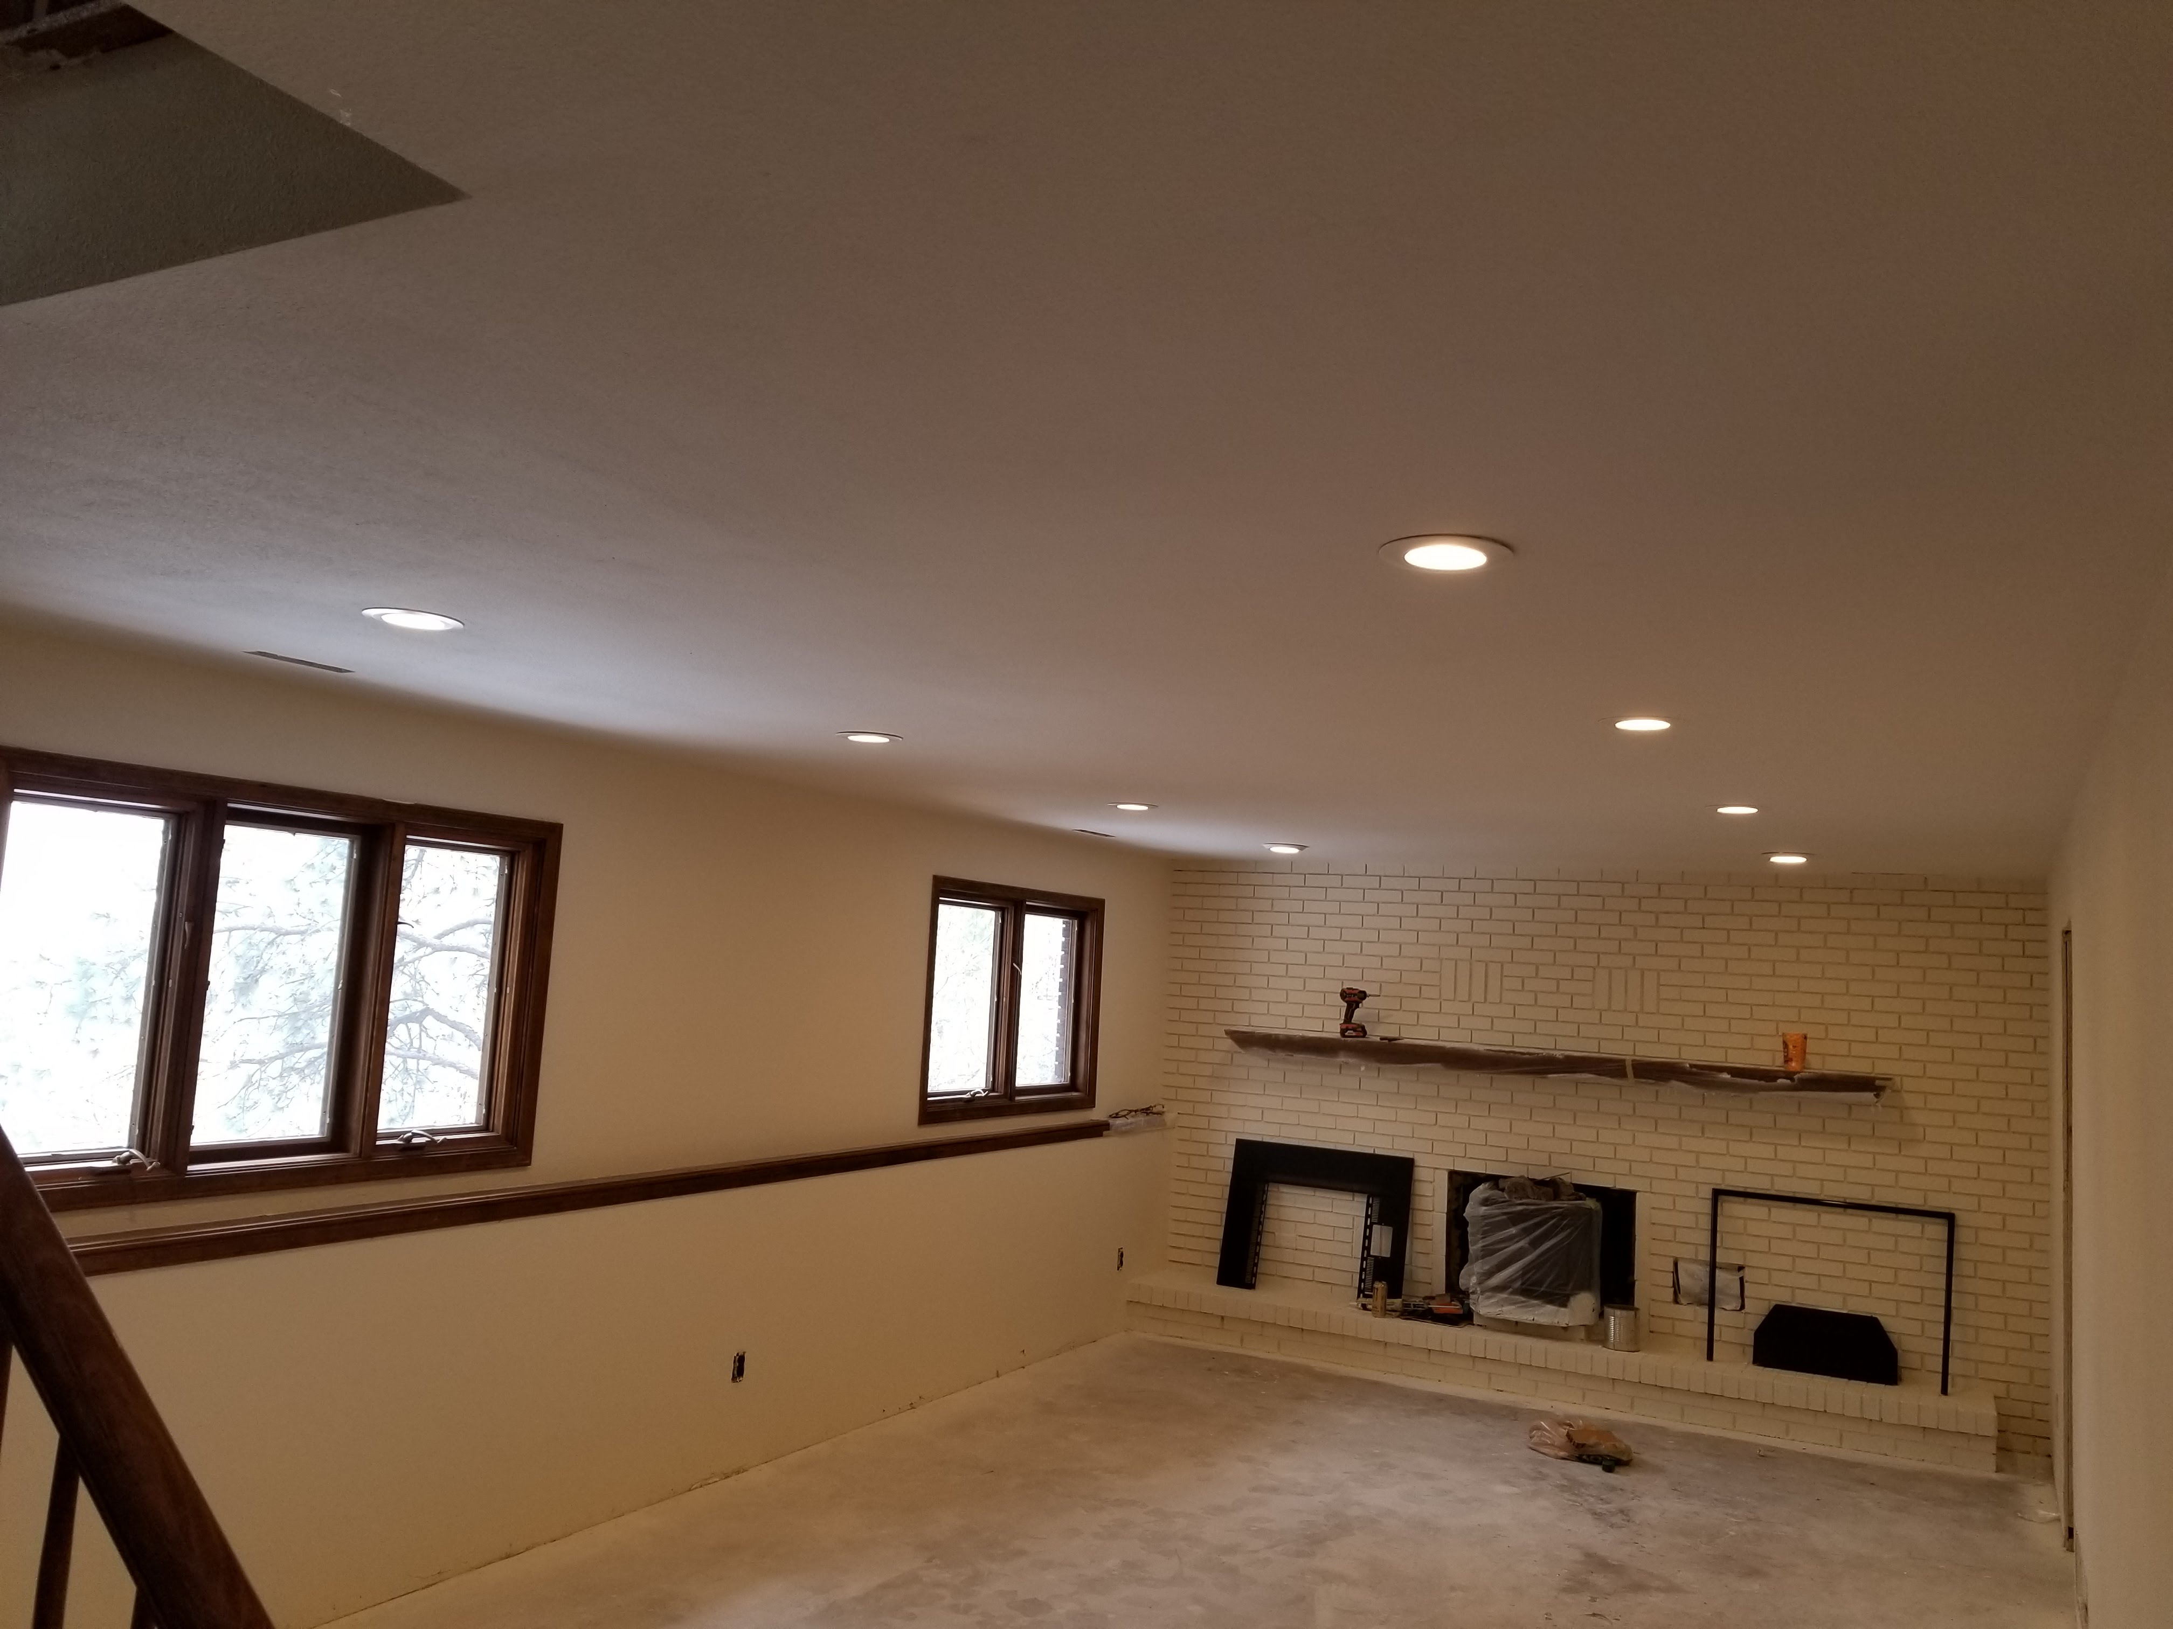
719-434-8361
We are canny about our lights!

Slide 15
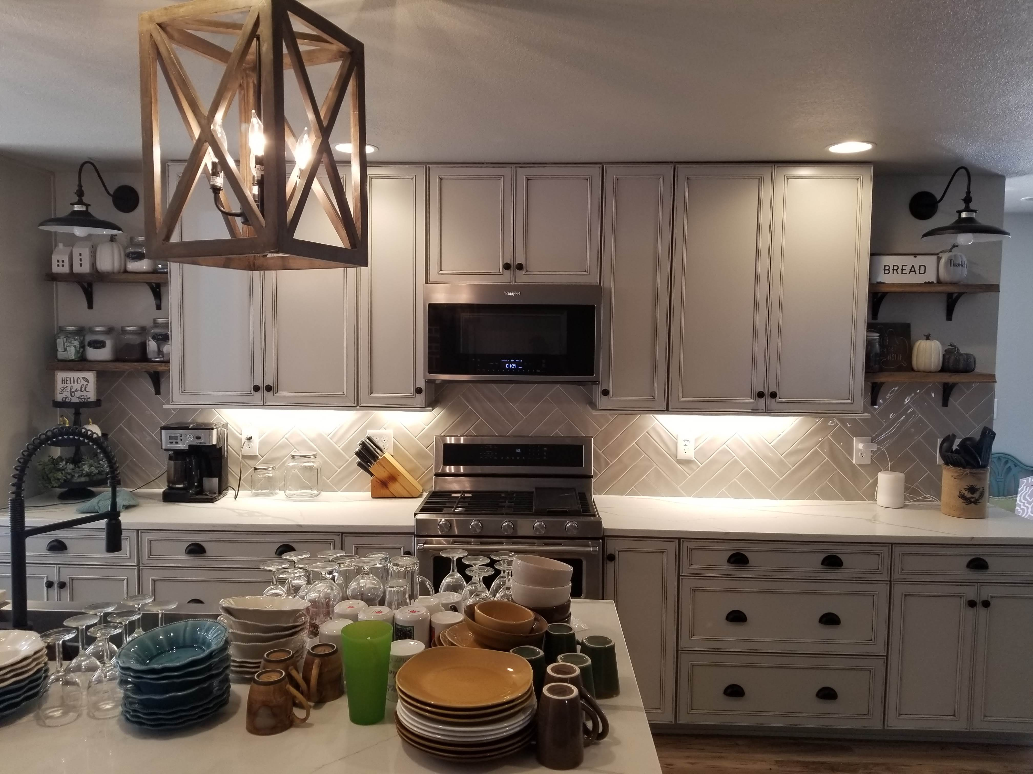
Are you itchin’ for a new kitchen?

Slide 16




Happy St Patrick’s Day
Celebrate Responsibly

